Slide 1
Algorithms for Clustering Highly Conserved Phylogenetic Markers
Christopher Hill
Advisor: Mihai Pop
Preliminary Exam
May 15th, 2014

Slide 2

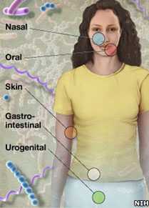
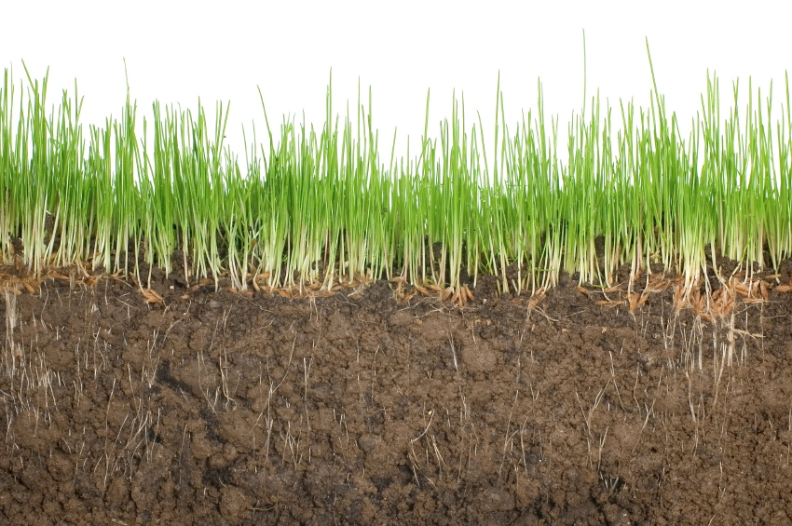
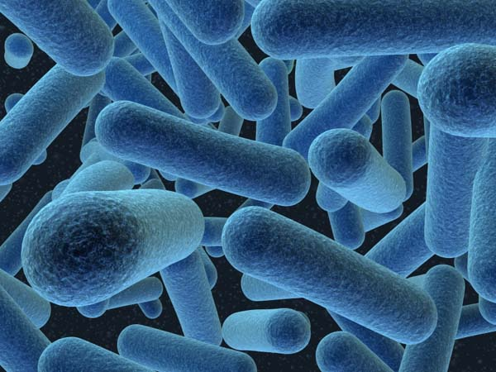
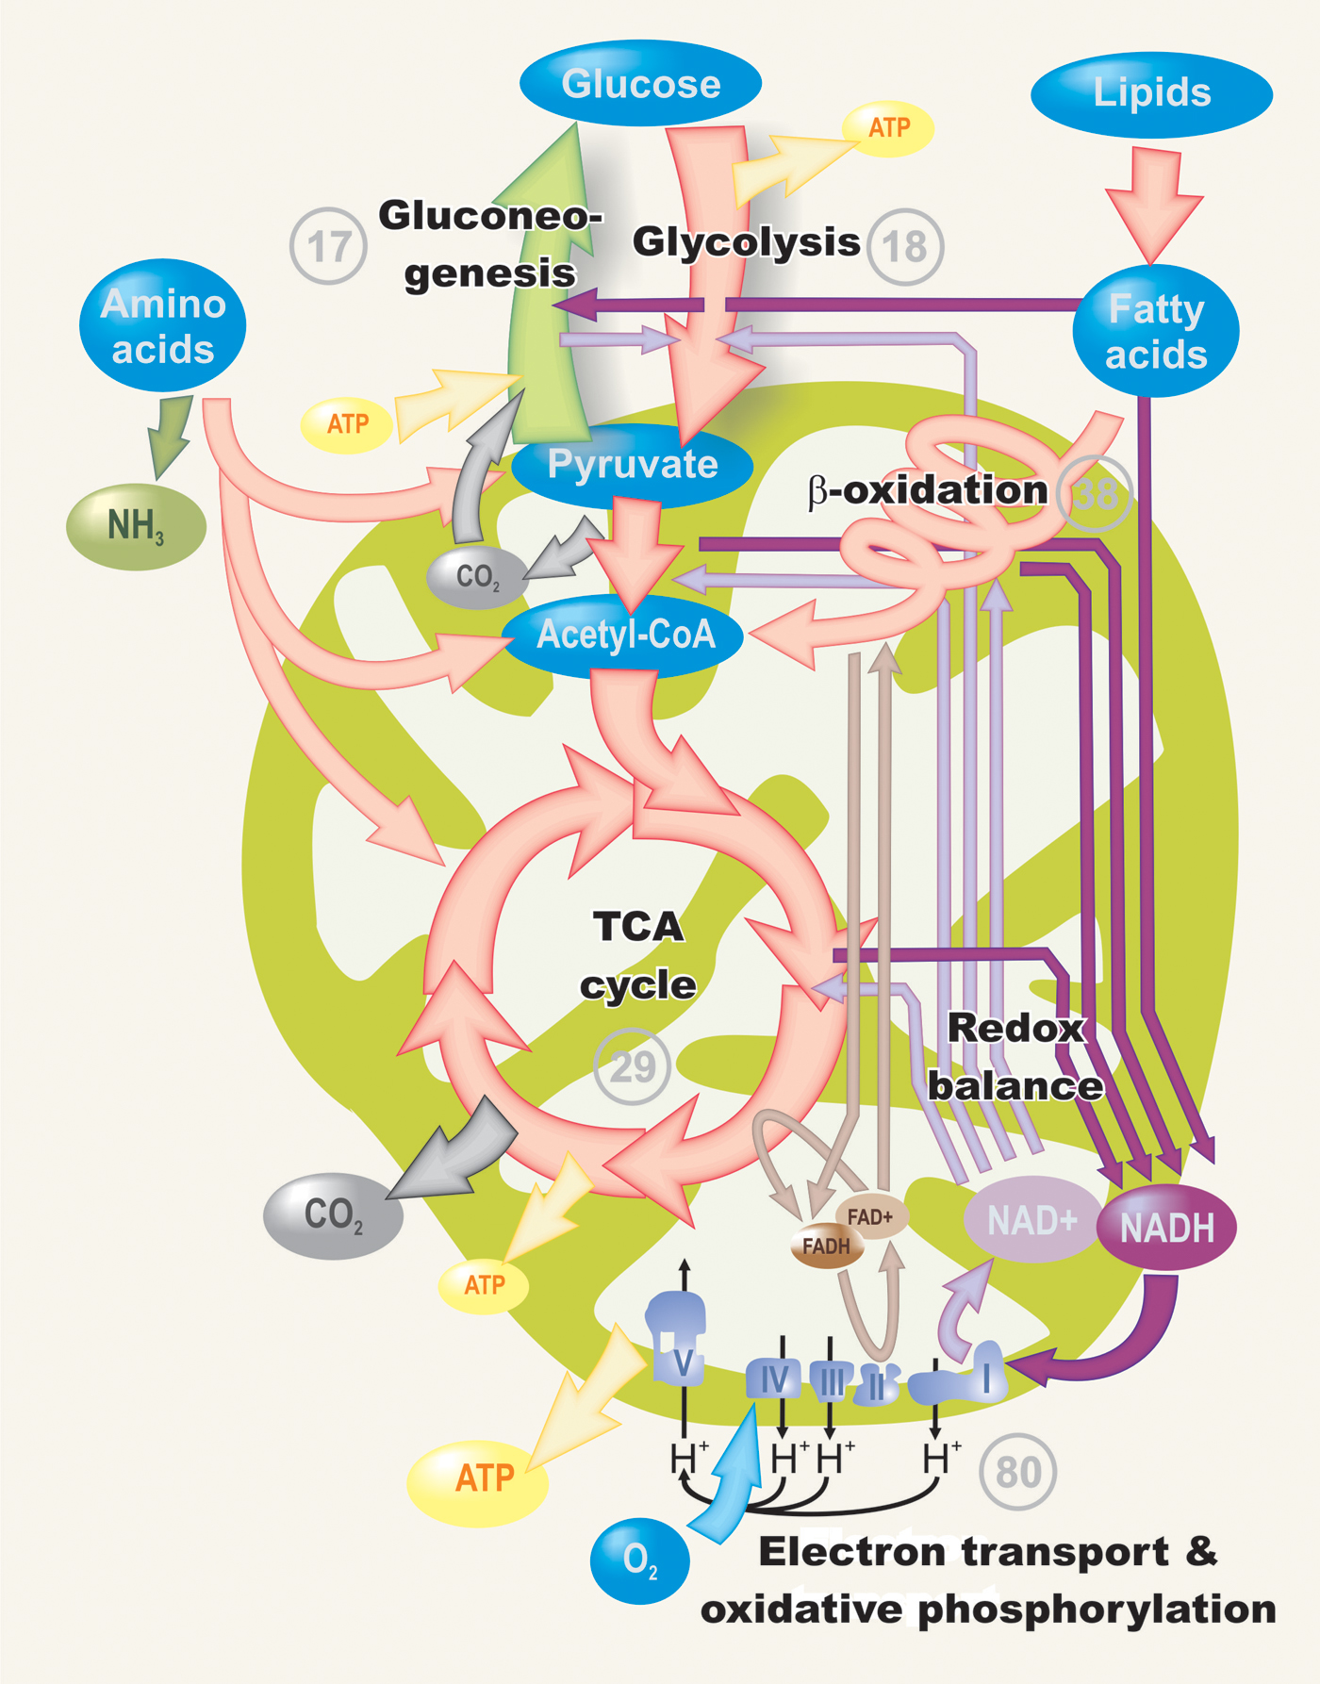
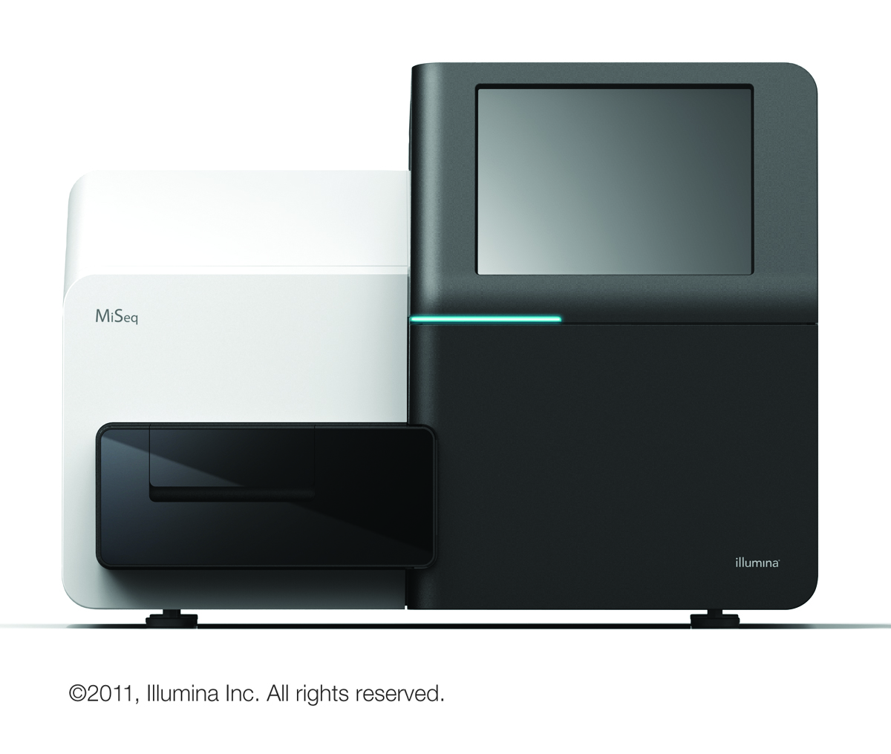
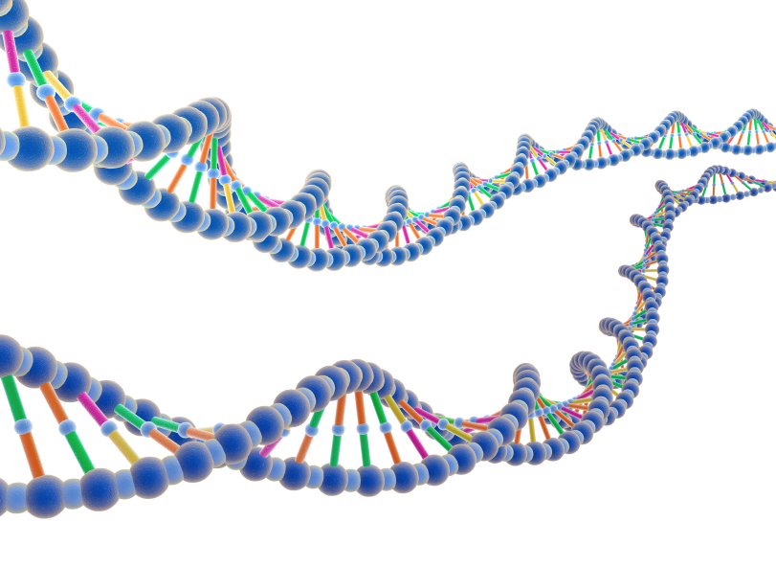
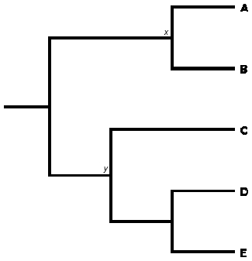
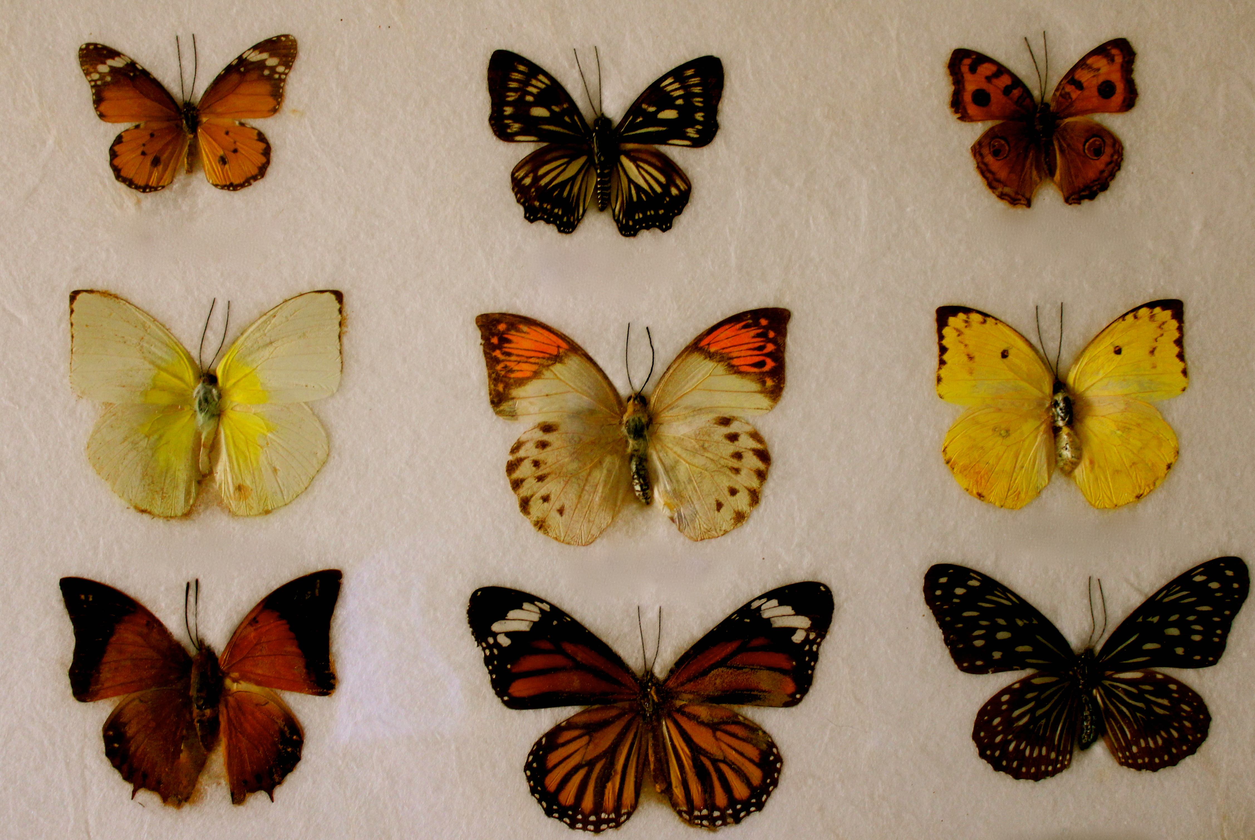
http://static.guim.co.uk/sys-images/Guardian/Pix/pictures/2012/9/26/1348685373327/Southern-Ocean-010.jpg
http://news.bbcimg.co.uk/media/images/60893000/jpg/_60893806_body.jpg
http://www.randyslawnservice.com/images/grass%20and%20soil.jpg
http://blogs.discovermagazine.com/loom/2010/03/04/i-for-one-welcome-our-microbial-overlords/#.U2vcMa1dWn0
http://blogs-images.forbes.com/matthewherper/files/2011/01/Illumina_MiSeqTM_CopyRight2011.jpg
http://ingridbrowning.com/wp-content/uploads/2011/08/IMG_3658.jpg

Slide 3
16S
16S
16S
…
16S
16S
16S
16S
16S
16S
16S
16S
16S
16S
16S
16S
16S
16S
16S
16S
16S
16S
16S
16S rRNA targeted sequencing
Whole genome shotgun (WGS)
sequencing

Slide 4
Goal
Millions of sequences
Super fast de novo clustering

Slide 5
Clustering

Slide 6
Hierarchical

Slide 7
1. Select a cluster center.
3. Repeat until no more
sequences remain.
2. Recruit sequences to center.

Slide 8
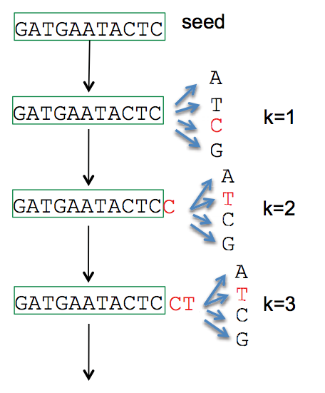
1. Select a cluster center.
Length | Abundance | k-mers
Longest remaining sequence
Run fast deduplication
…
CD-HIT (Li et al. 2006)
UCLUST (Edgar 2010) DNACLUST (Ghodsi et al. 2011)
UCLUST (Edgar 2010)
AbundantOTU (Ye 2010)

Slide 9
2. Recruit sequences to center.
k-mer distance
Edit distance
similarity
identity

Slide 10
Edit distance

Slide 11
K-Difference Algorithm

Slide 12
Parallel clustering

Slide 13
Ambiguous assignments

Slide 14
Longest remaining sequence becomes the new cluster center.
1. Select a cluster center.
3. Repeat until no more
sequences remain.
…
2. Recruit sequences to center.
Any sequence that is within a specified edit distance or similarity from the cluster center is recruited by the cluster center.

Slide 15
Hidden

Slide 16
Test

